Slide 1
Virtual Reality Staging & Touring
By: Nasya Capetillo, Dylan Stimac, Hafiz Akinteye, Jeremy Culver, Matthew Tate, Zachary Gray, and James Baker

Slide 2
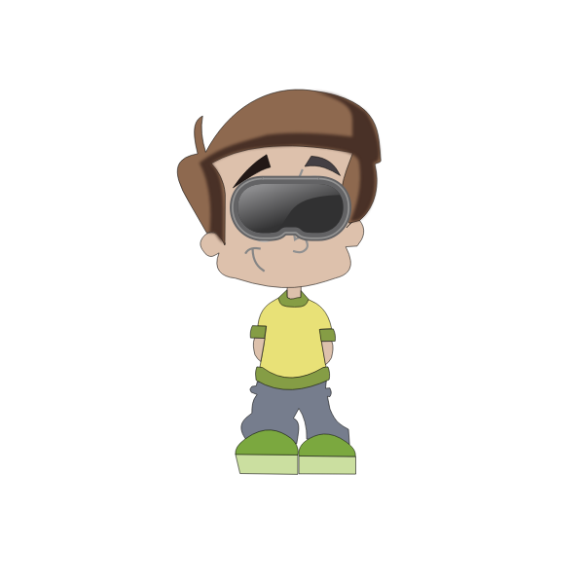

Objective
Design and Implement Virtual Touring and Staging Software
Virtual reality software is in its infancy and has extreme growth and implementation potential.
Virtual touring and staging software allows for users to access immersive, true representations of any captured location from the comfort of their homes.
The tourism and real estate sectors are plagued with issues that create issues of inaccessibility for potential customers, hindering market growth

Slide 3
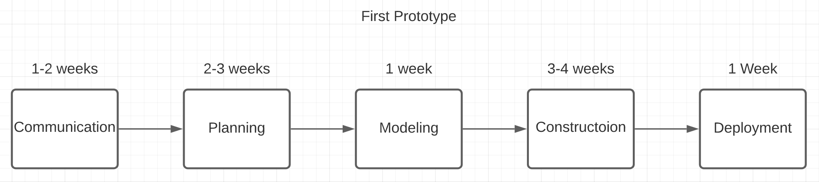
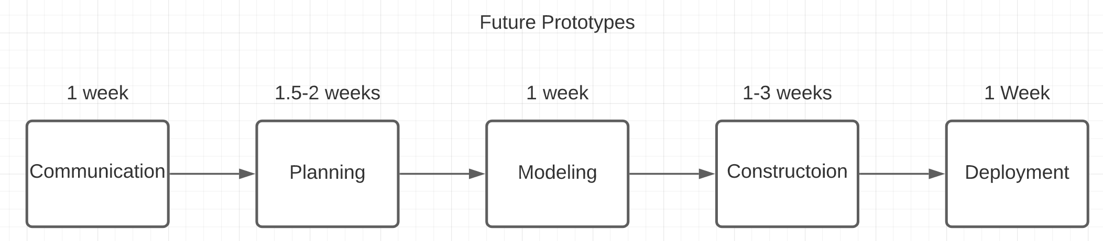
Project Timeline
Since VR software is already well established, the prototyping model would be effective for this project. The first prototype would take the longest, assuming the start is Jan 2021:
This assumes weekends are not counted and 3 prototypes until completion, Total weeks is: 19-26 week long project
Notes:
As the project gets closer to a completed state, the total time it takes to make each new prototype will decrease. Phases like modeling will stay the same length but both planning and coding will become easier and easier with each successive prototype as more code and planning can be reused.

Slide 4
Software Process Model
Incremental Process Model
Reality Capture
HUD
Location Information
User-Access
Software module that interacts with reality capture hardware to generate virtual, tourable properties
Interactive, togglable menu options that provide users access to location information
Editable information storage that contains pertinent information such as: sqft., number of rooms, survey lines, hookup type, etc.
User access to reality capture servers, ability to tour properties, and specify favorite properties

Slide 5
Functional Requirements
Users must be able to virtually tour a wide variety of homes they are interested in buying.
Users must also be able to browse locations to tour and have the ability to add any locations to a favorite list.
Sellers must have some functionality for them to upload videos/renders of the home they are selling.
Agents must be able to communicate with users while the virtual tour takes place to answer questions.

Slide 6
Non-Functional Requirements
Usability: The product must be easy to use for consumers, and easy to use for people uploading their home tour
Performance: The program should run at least 30fps, and should require content submitted by sellers to be of high quality Space: The program should not take up an excessive amount of storage space
Dependability: The program should run correctly every time unless it is down for routine maintenance Security: Only authorized users should be able to log in and view homes for sale. Only approved and screened sellers should be able to upload their homes for sale
Environmental: This project should not have any environmental impact but will have to comply with United States law regardless
Operational: The finished product must be able to be used from every standard VR device, and have easy to use signups for buyers and sellers
Development: This project will be developed by our team in a timely fashion, implemented using the MVC pattern Regulatory: This project will need to comply with consumer privacy laws in the United States and during its development must abide by workplace regulations
Ethical: This project must allow users to remove their homes from the site if they do not feel safe, and protect users from abuse of the system by unauthorized access
Accounting: This project must keep an accurate record of all funding received, and track expenses to give shareholders their fair share of returns
Safety/Security: This project needs to abide by US law regarding software security, and have adequate protections to make sure no unauthorized access occurs, and that authorized users do not abuse the power they have.

Slide 7
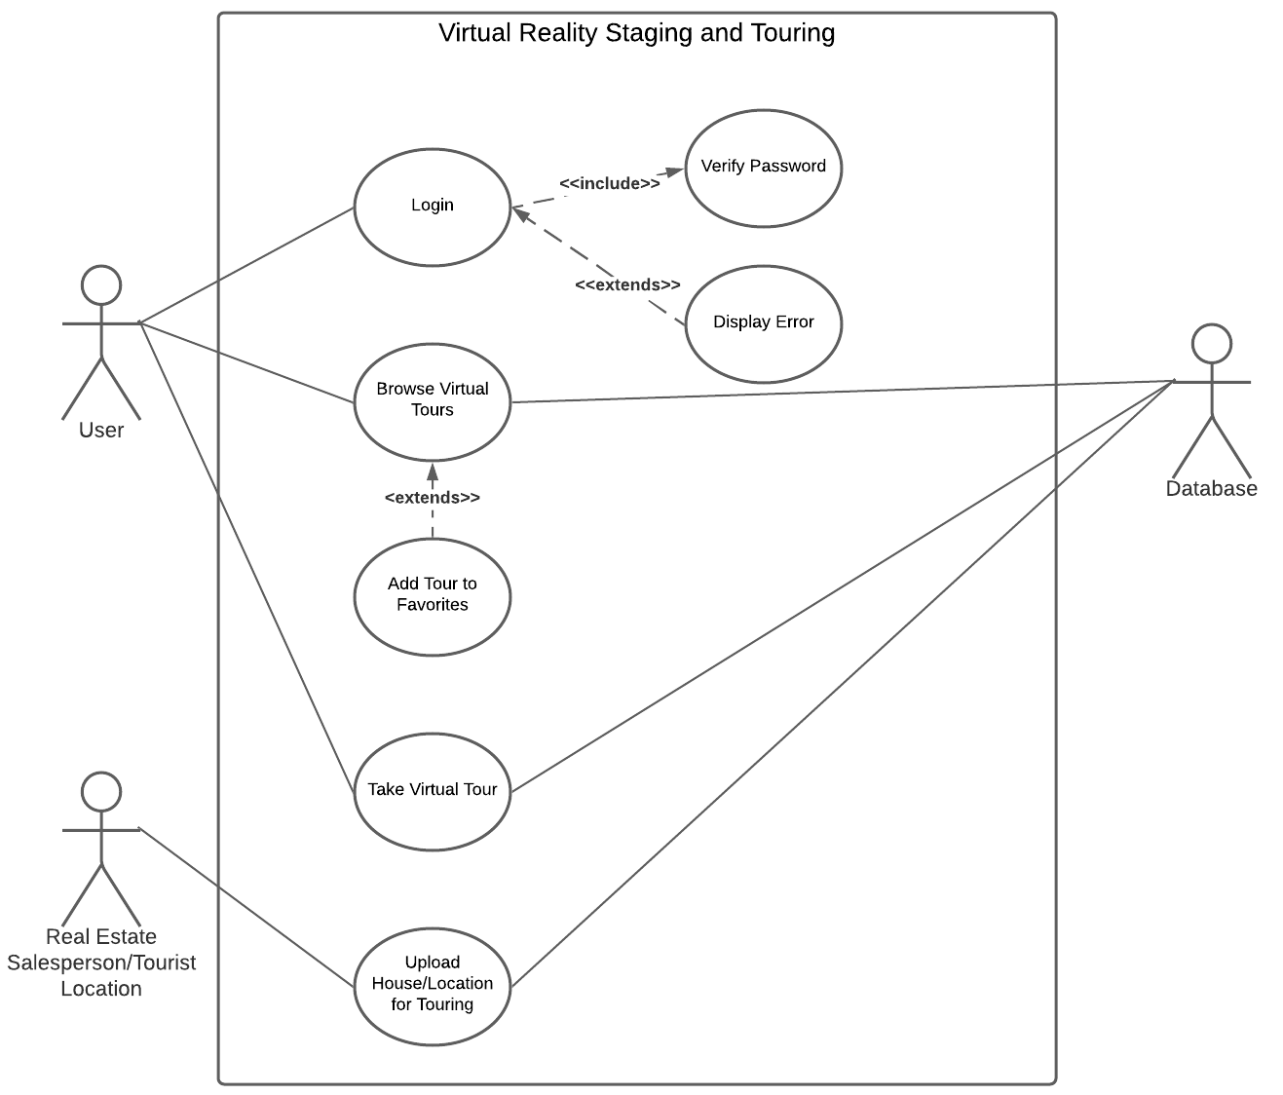
Use Case Diagram
Notes:
Our use case diagram has three actors: the user, the real estate salesperson/ tourist attraction, and the system database. The user and salesperson are on the left on the diagram as they initiate the interaction with the system, while the database is on the right side as it is reactionary and reacts to the actions of the other actors. The user will first login to the system, which will require a password verification. Once the user is logged in, they can choose to browse virtual tours or take a tour. If a user browses tours they can choose to add a tour to their favorites, as shown by the extends modifier, and save it for future reference. All of these user interactions require reactions from the database as it provides the list of tours and the location. The real estate actor only has the ability to upload their location to the database for users to tour as well as any prevalent information regarding the listing or location.

Slide 8
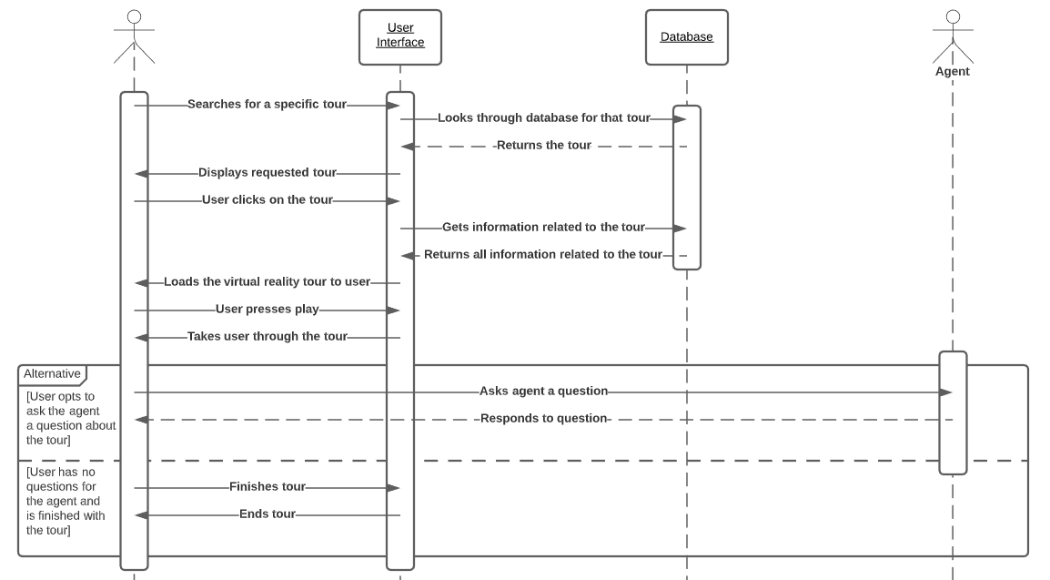
Sequence Diagram
Notes:
When it comes to the use cases for our project, we decided that taking a virtual tour is clearly the best representative operation for the software. The sequence diagram for this use case involves two actors as well as both a user interface and a database. The first actor is the user. The user directly interacts with the user interface when it comes to both searching for tours and actually experiencing the tour in virtual reality. The second actor is the agent, who interacts with the user in order to answer any questions while the user is taking the tour. Finally, the user interface interacts with the database in order to retrieve the list of tours as well as the necessary data for the user to take a tour.

Slide 9
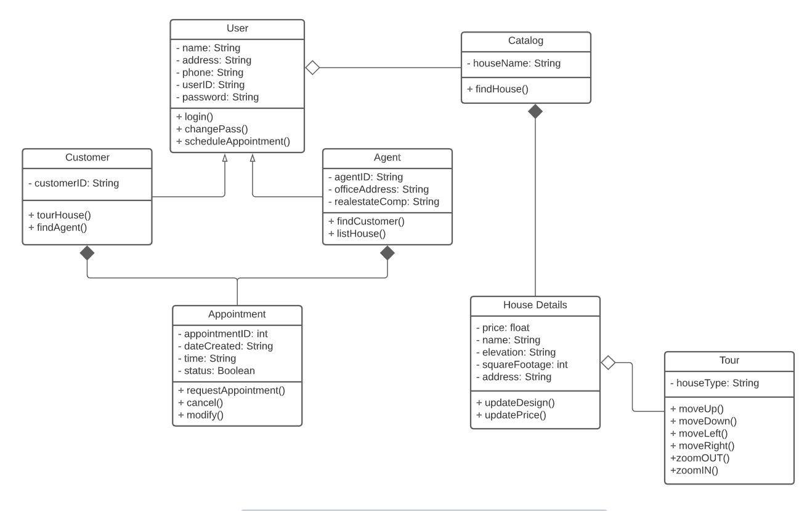
Class Diagram
Notes:
Our class diagram is divided into 7 different classes. We have User, Customer, Agent, Appointment, Catalog, House Details, and Tour. All users will belong to the User classes which holds their name, address, phone, userID, and password Users are then specified by Customer and Agent who have special functions. Both Customer and Agent will be able to interact with the appointment class where they can request, modified and cancel appoints.
All users will be able to access the catalog which holds housing details. After selecting a house the user is interested in they are then able to tour it.

Slide 10
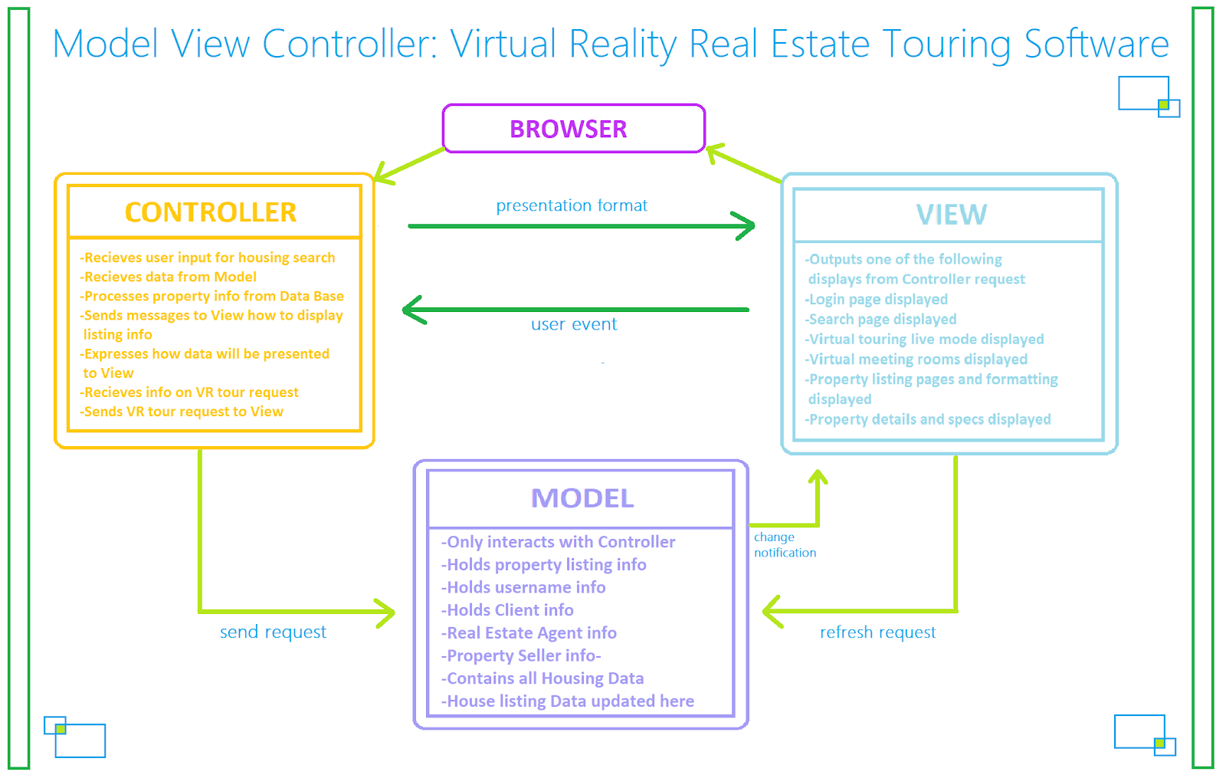
Architectural Design

Slide 11
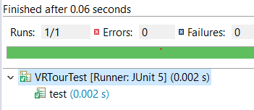
Software Testing
Unit Testing: Black-Box Testing Techniques (Cause & Effect)
Integration Testing: Regression Testing w/ JUnit
Validation Testing: Beta Testing
Notes:
In order to test our software we will go through the software testing process and apply unit testing, integration testing, validation testing, and system testing. For unit testing, we decided to implement black-box testing techniques in order to effectively test the functionality of our software. This will allow us to test different inputs and the effects they may have on the output and to ensure that every unit of software functions correctly. We will also use a decision table to implement cause and effect testing techniques. Next, we will implement integration testing via regression testing. Regression testing will allow us to protect against unwanted behavior whenever any changes are made to the software. This will be important for our product as we do not want consumers to experience any bad side effects. This will also be accomplished with the help of automatic testing tools, such as JUnit as seen in this example where this test case tests correctly. Finally, validation testing will be achieved through beta testing. Beta testing will allow for many users around the world to get a feel for the software and they will be given a demo location to explore through their headset. This will allow us to get valuable feedback and information on the current state of the software, and the feedback will be from fresh eyes and unbiased so we can perfect the software before release.

Slide 12
Cost, Effort, and Pricing Estimation
Using the function point method, we calculated the GFP would be 158.
The number of user input will be 13 with an average complexity
The number of the user output would be roughly 5 with a simple complexity,
The number of user queries is 3 with an average complexity
Number of data files and relational tables is 4 with a complex complexity
Number of external interfaces is 2 with an average complexity.
The total of count x complexity gives us a GFP of 158.
An average virtual reality touring software would have roughly 40,000 lines of code.
Given: Average productivity for systems of this type = 620 LOC/pm
Labor rate = $2,000 per month with approximately $6 per line of code
Total estimated project cost = $6 x 40,000 = $240,000
Estimated effort = 40,000/620 = 65 person-months
Servers for storing the database of housing, prices, and other information would cost roughly $3,000 ~ $4,000 taking maintenance into account. Software license would cost roughly $25,000
Support would cost roughly $6,000
In this case, we have 7 members working on this software. $240,000 / 7 = $34,286 per member.
Notes:
In this slide, we will be talking about cost, effort, and pricing estimation. Using Function Point Method, we calculated the GFP would be 158. This is from getting the number of user input as 13 with an average complexity. The number of user outputs would be roughly five with a simple complexity. The number of user queries is three with a simple complexity. Number of data files and relational tables is four with a complex complexity. The number of external interfaces is two with an average complexity. Getting the multiplication of count and complexity gives us a GFP of 158. An average virtual reality touring software would have roughly 40,00 lines of code. We know that the average productivity for systems of this type is 620 lines of code - person month. Labor rate is about $2,000 per month with approximately $6 per line of code. Total estimated project cost gives us $240,000 by multiplying 40,000 times six. Estimated effort is 65 person months. Servers for storing the database of housing prices and other information will cost roughly 3,000 to 4,000 dollars including maintenance. Software licenses cost about $25,000. Support would cost roughly $6,000 in this case since we have 7 members working on the software. We get 30 roughly 34,000 per member.

Slide 13

Conclusion
Challenges and Changes
Project Management
Software Planning

